Slide 1
Innovation Initiatives for Schools
School Innovation Ambassador Training Program (SIATP)
https://sia.mic.gov.in
School Innovation Council - https://sic.mic.gov.in
Design Thinking and Innovation Subject - https://sia.mic.gov.in/DTI
https://sia.mic.gov.in/assets/doc/school-innovation-policy.pdf

Slide 2
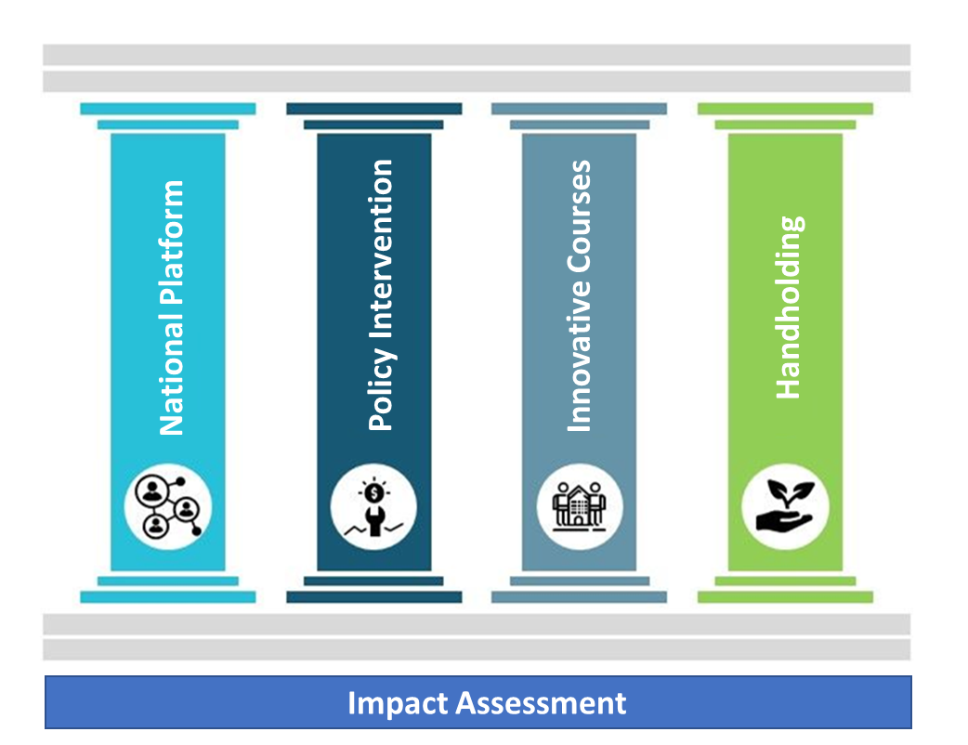

Interventions

Slide 3





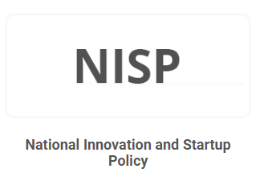

Innovative Initiatives
For Higher Education Institutions
For Schools
School Innovation Ambassador Training Program (SIATP)
School Innovation Council
National Innovation Entrepreneurship Promotion Policy for School
Regional Indovation Centers
Investor Network
Smart India Hackathon
Design Thinking and Innovation Subject for School

Slide 4
Invention Vs Innovation
Invention Vs Innovation
Invention marks the creation of a new concept, while innovation involves its commercialization for societal benefit
Innovation is the Process of transforming ideas into commercial reality, services that create value in life.
Innovation plays a major role in the Society

Slide 5
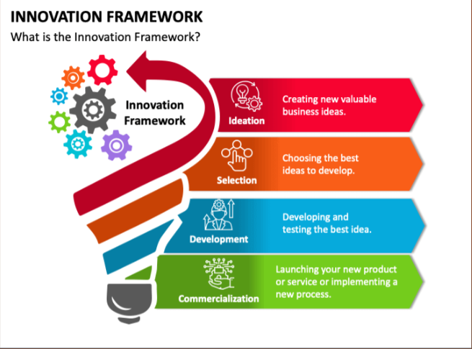

Slide 6
Innovation Initiatives for Schools
School Innovation Ambassador Training Program (SIATP)
https://sia.mic.gov.in
School Innovation Council - https://sic.mic.gov.in
Design Thinking and Innovation Subject - https://sia.mic.gov.in/DTI
https://sia.mic.gov.in/assets/doc/school-innovation-policy.pdf

Slide 7

https://sic.mic.gov.in

Slide 8
Why School Innovation Council
Currently, we are Concentrating on:
Exams
Marks / Grades / Percentages
Which is a basic need for any student to pursue his / her higher education. We have an established system in practice to achieve the Marks and %.
+
For Future Requirements, our students should be empowered with skills on :
Creative thinking, Design thinking, Out-of-box thinking, and Problem-Solving abilities
Ideation, Innovation, and Entrepreneurship
To empower this skill to teachers and students, the School Innovation Council was launched.

Slide 9

School Innovation Council
Objective of School Innovation Council is to foster the culture of Ideation, Innovation and entrepreneurship (IIE) among teachers and students.
SIC will enable mindset change and awareness on creative thinking, design thinking, Problem-Solving abilities, out-of-box thinking, Prototyping, Product Development and IP commercialization among teachers and students.
Systematically measuring and enabling the ranking system for schools on the level of innovation-oriented activities.

Slide 10
School Innovation Council Composition
Executive representatives-
  Chairman of the SIC School Principal (or equivalent)
  Convener/ Activity Coordinator- School Vice Principal/ Senior teacher.
Teacher representatives:
  Innovation ambassadors trained under SIATP of MIC.
  Additional members for coordinating major activities (not more than 5)
  Atal Tinkering Lab in charge (if ATL exists in the school)
C. Social Media Coordinator
D. Student representatives:
  School captain/ head boy/head girl from the school
  Student Members
E. External Expert Representatives: successful entrepreneur, officer from nearby Incubation/ pre-incubation centre, IPR expert, senior industry experts having experience in sales/ marketing/ product design/ product manufacturing etc.

Slide 11
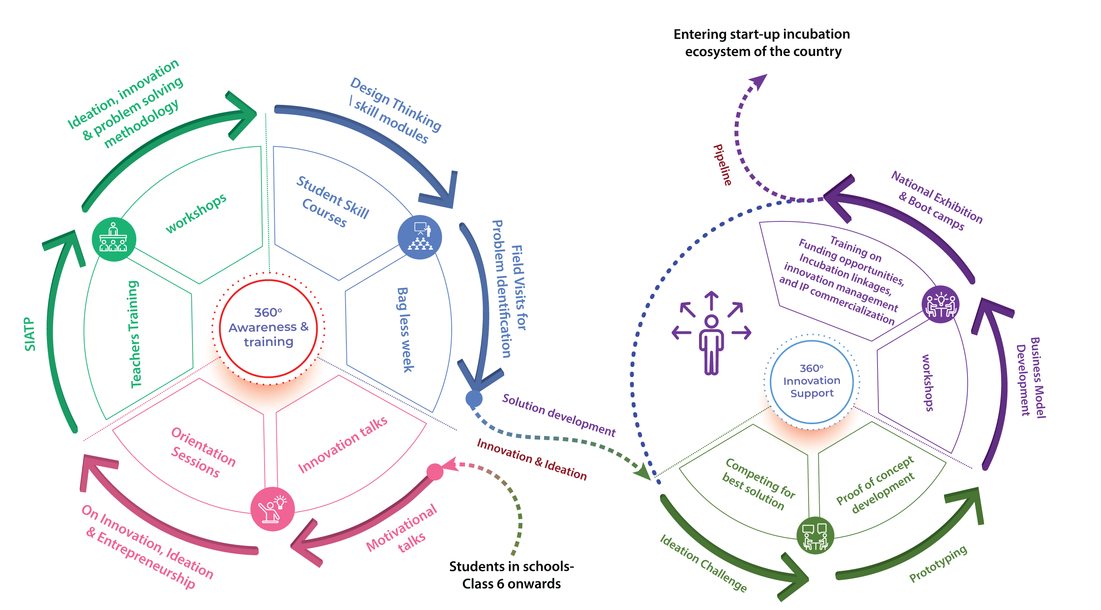
SIC Program- 360 degree approach

Slide 12

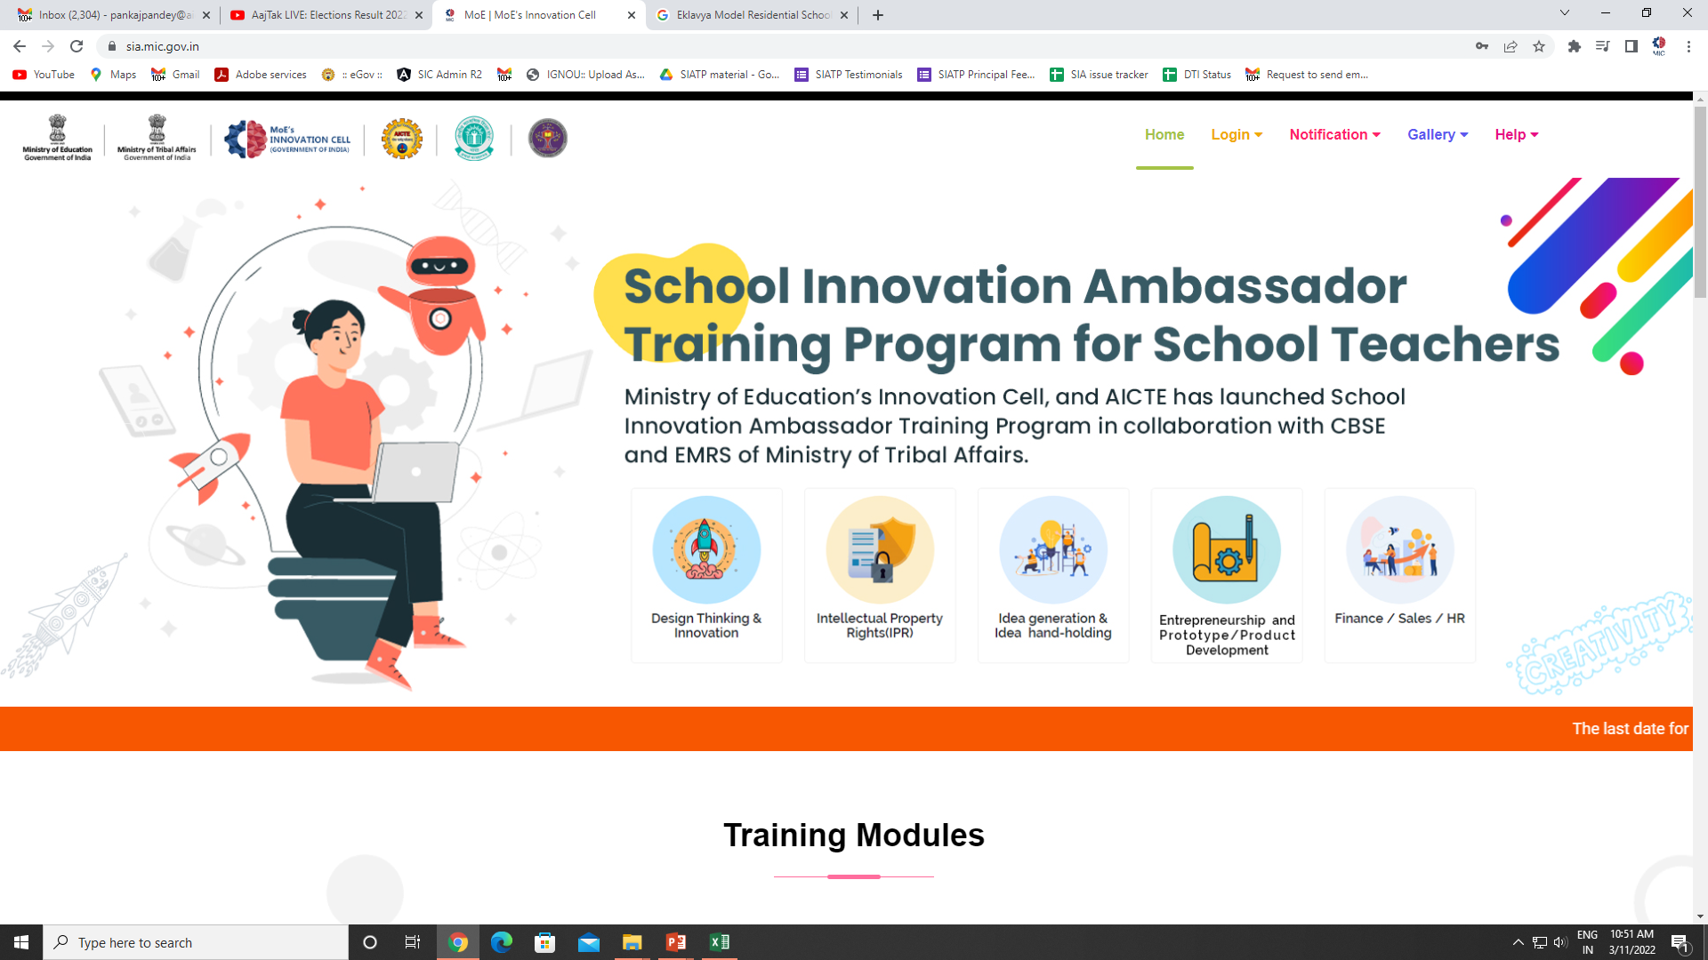
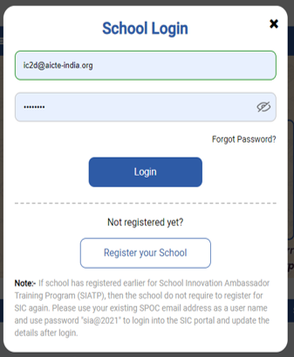

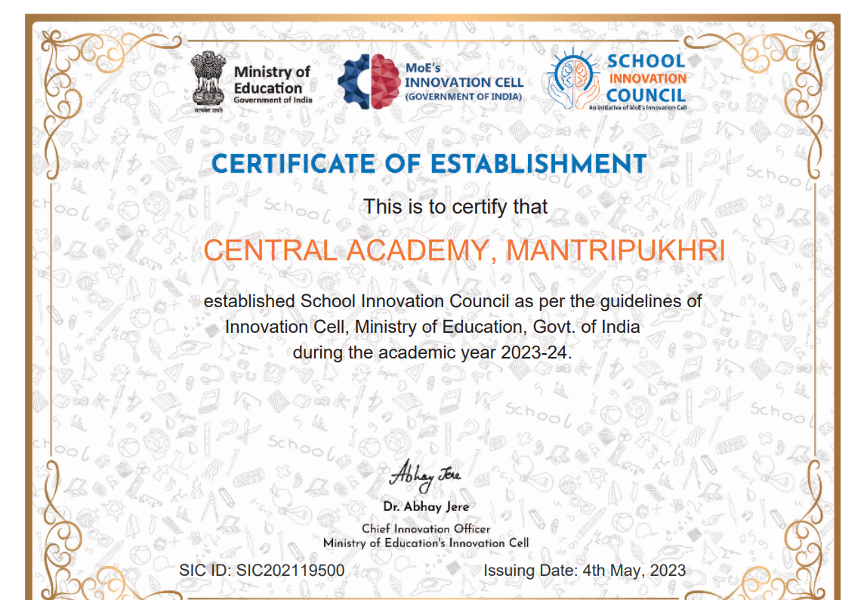


SIC Process
Form SIC council
School
Register on SIC
Website
Perform Activities
Month Wise
School login
Boot Camp
Funding
National Level Exhibitions
Submit Ideas, POC and Business Model Development

Slide 13
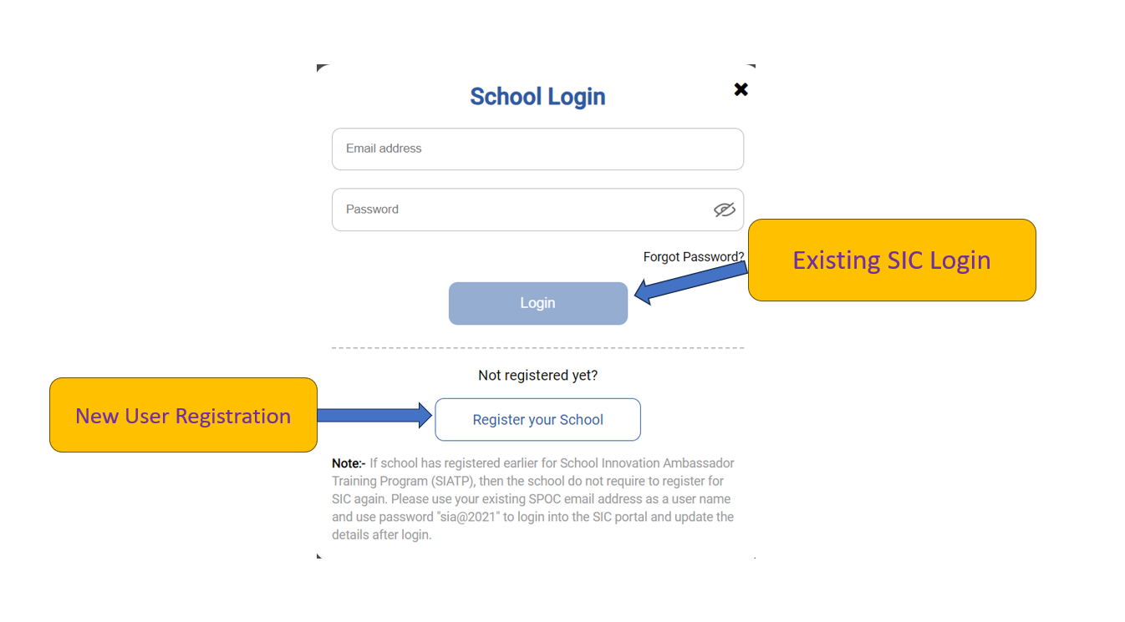
New School Registration
To Login into SIC Portal:
The email id is your school email id / registered email id.
Default Password- “sia@2021”

Slide 14
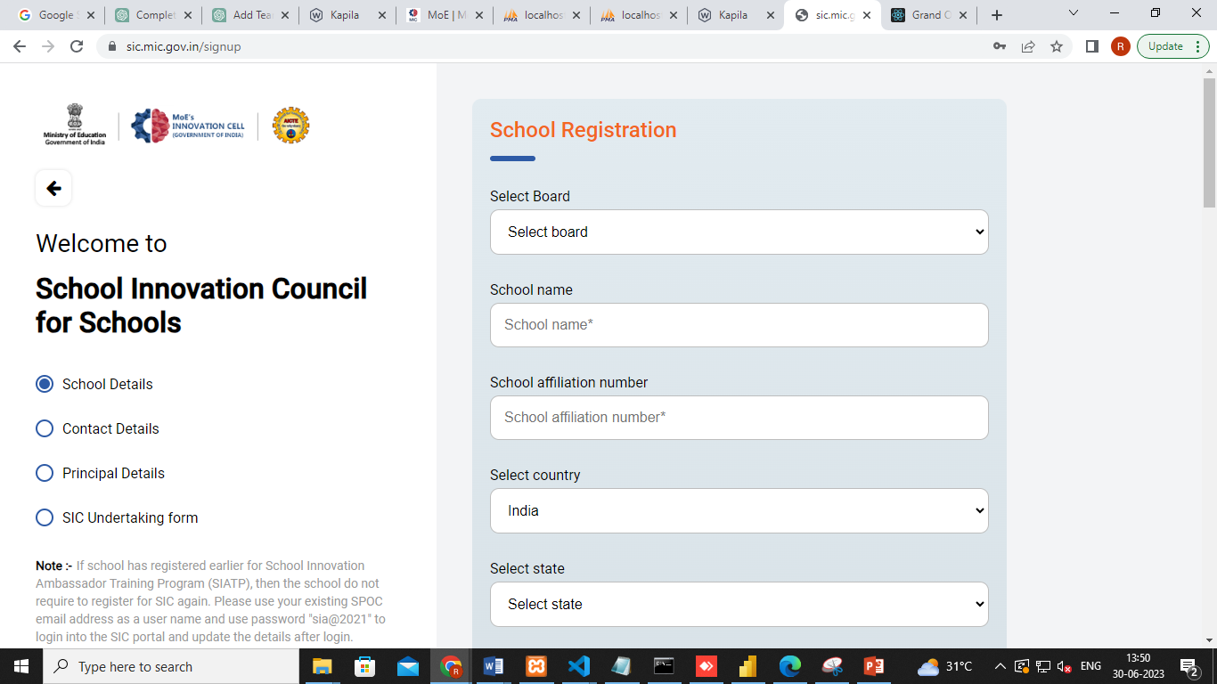
New School Registration – Fill the School Details
New Schools can register on SIC Portal. Providing the relevant Details

Slide 15
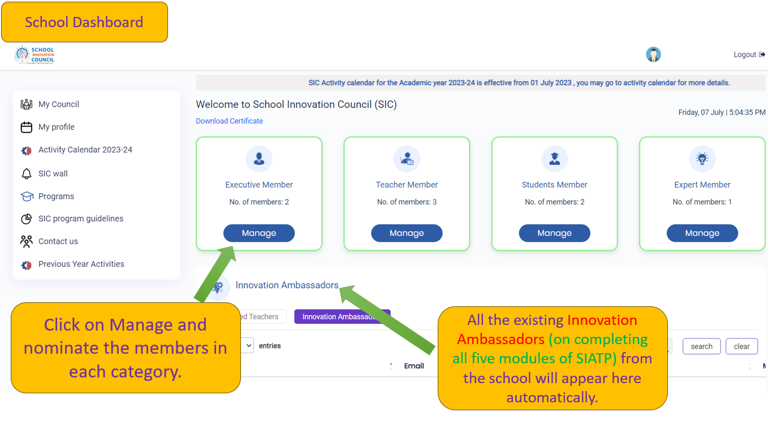
Nomination of Council members
Note: Executive Members will be able to login to their SIC account with their registered email. For pre-registered schools, the existing SPOC can update the details here and nominate members as per guidelines.

Slide 16
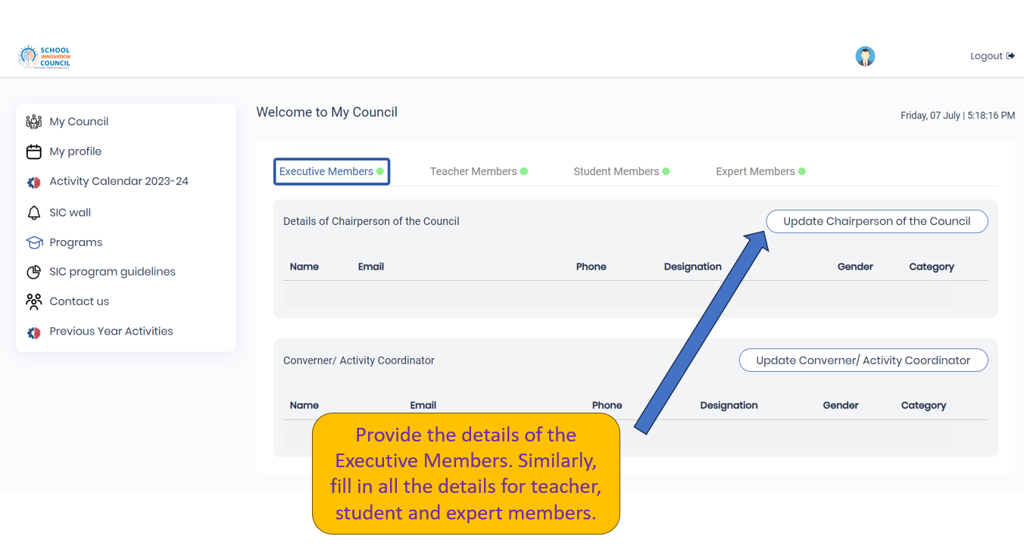
Fill the details of Executive Members

Slide 17
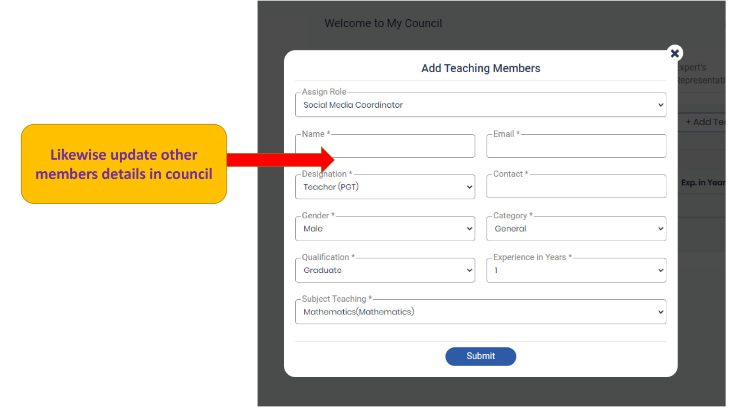
Fill the details of Teacher Members

Slide 18
SIC Certificate of Establishment

Slide 19
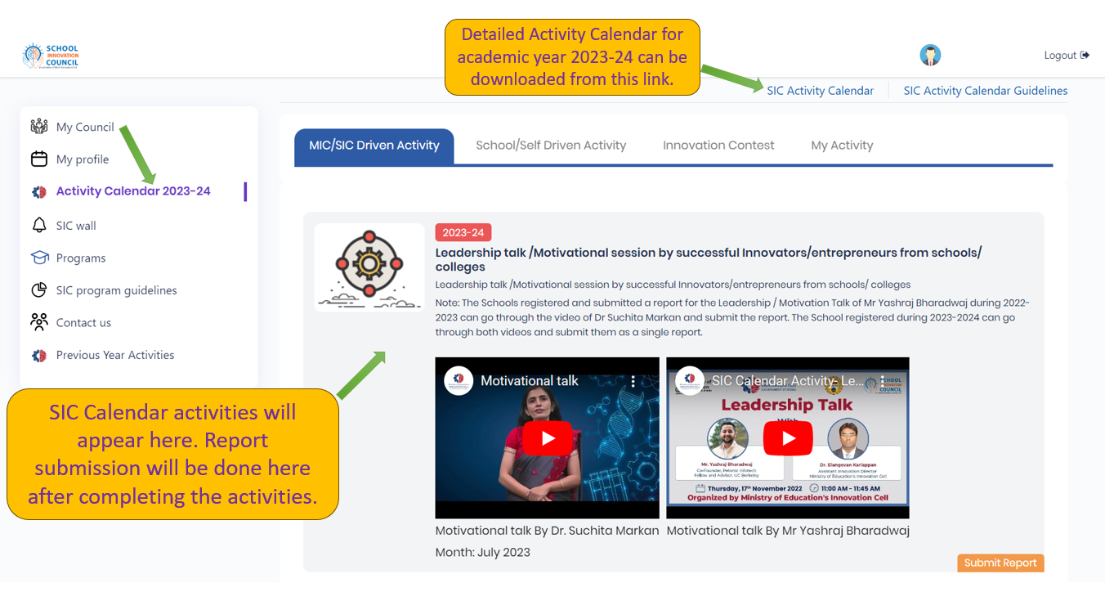

Slide 20

Motivational Talk

Slide 21
School Innovation Contest – Stages
STAGE 1:
Idea Submission: Ideation to PoC
STAGE 8:
National Level Exhibition in Delhi (29th July)
STAGE 2:
Regional Mentoring Session
STAGE 7:
File IPR (Intellectual property rights) with KAPILA
STAGE 3:
PoC to Prototype development
STAGE 6:
Product Development
STAGE 4:
Business Model Development
STAGE 5:
Boot camps

Slide 22
Future Skill Empowerment for Students
When our students are involved in Ideation, PoC/Prototype, Business Model Development, and Product Development
Our Student will be empowered with the required skills:
Creative thinking
Design thinking
Out-of-box thinking
Problem-Solving abilities
Ideation
Innovation, and Entrepreneurship

Slide 23
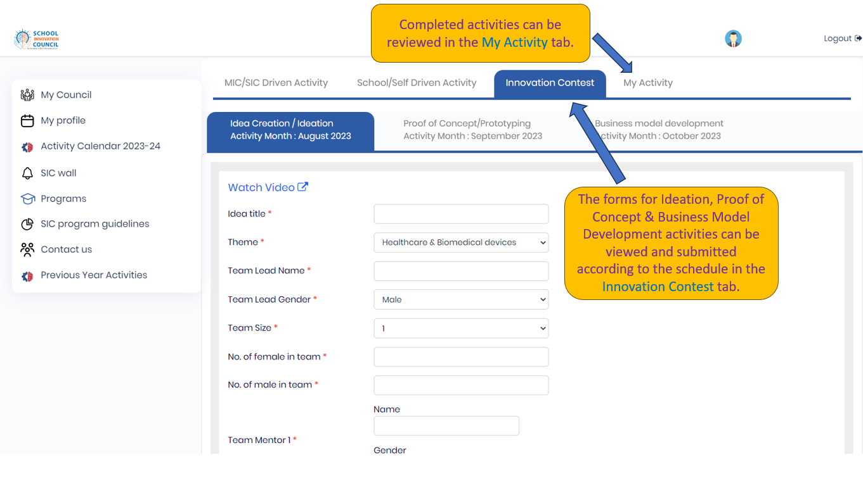
Innovation Contest

Slide 24
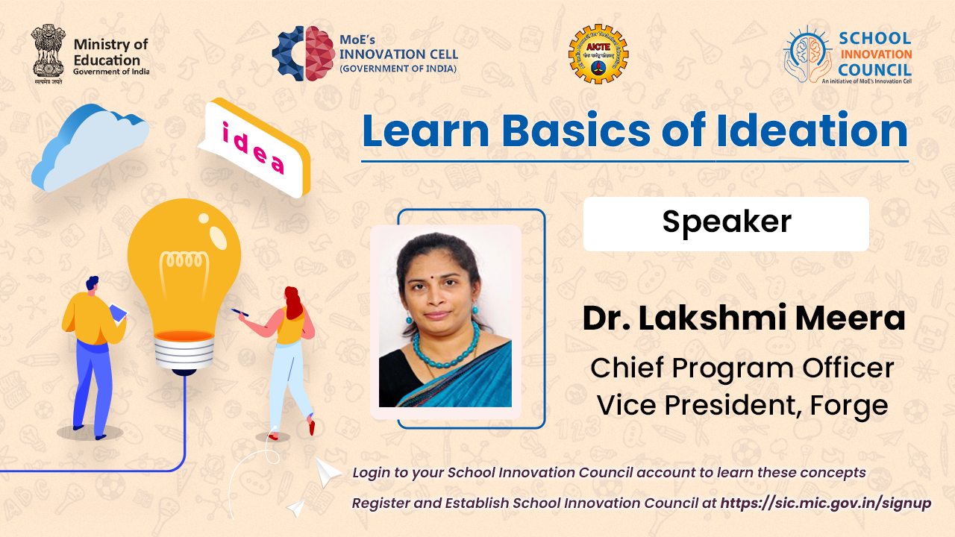
Ideation

Slide 25
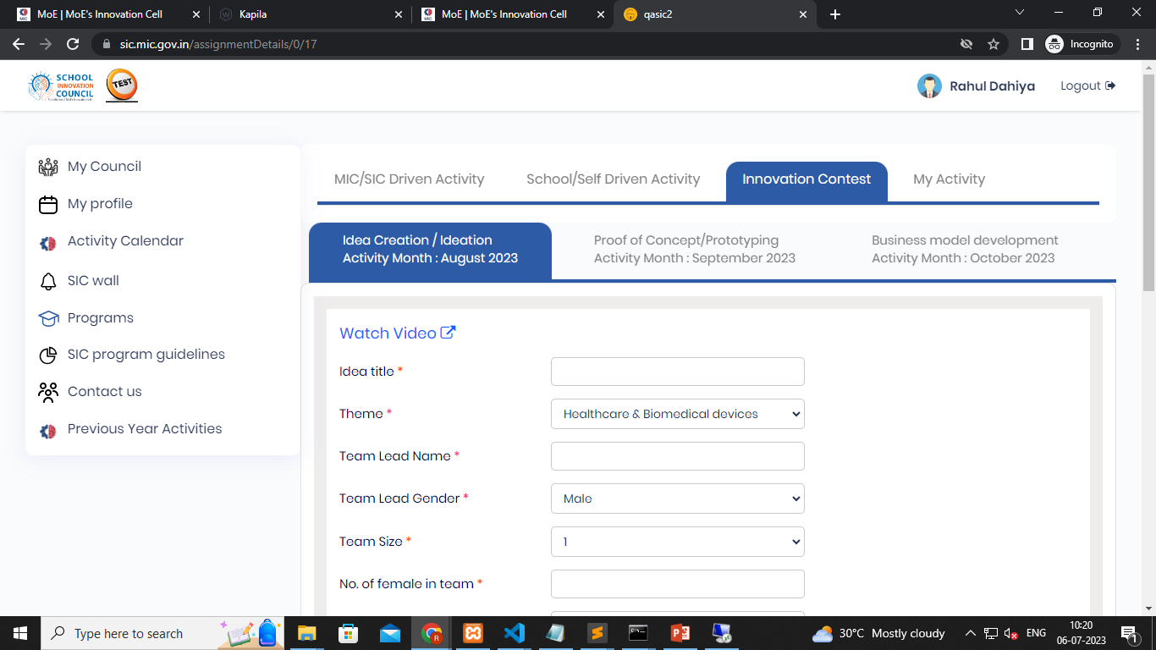
Ideation
Submit your Ideas

Slide 26
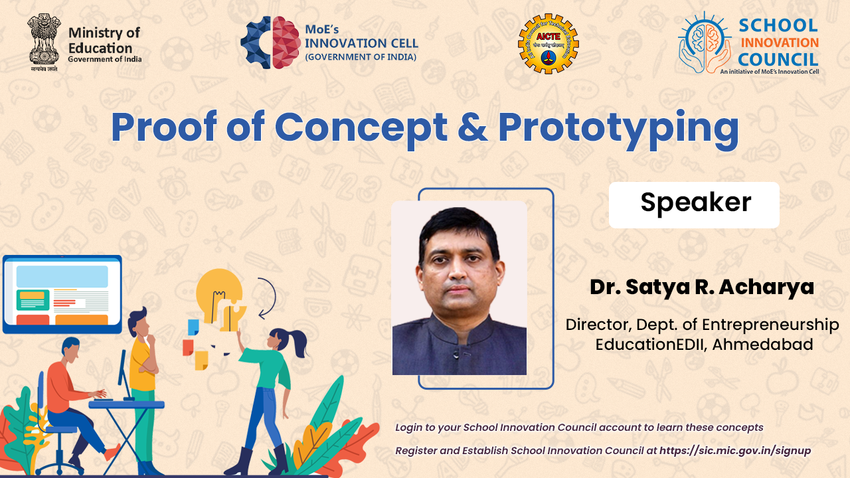
Proof of Concept & Prototyping

Slide 27
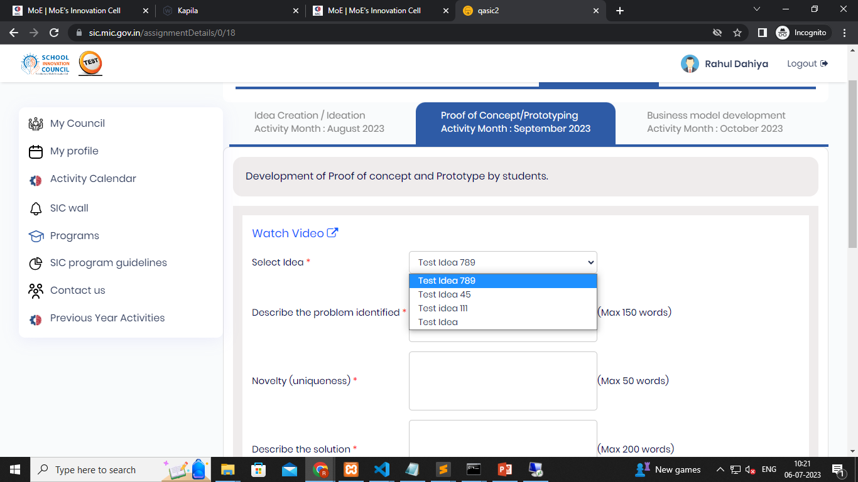
Proof of Concept & Prototyping
The ideas submitted in the Ideation will move to the PoC / Prototyping stage automatically

Slide 28
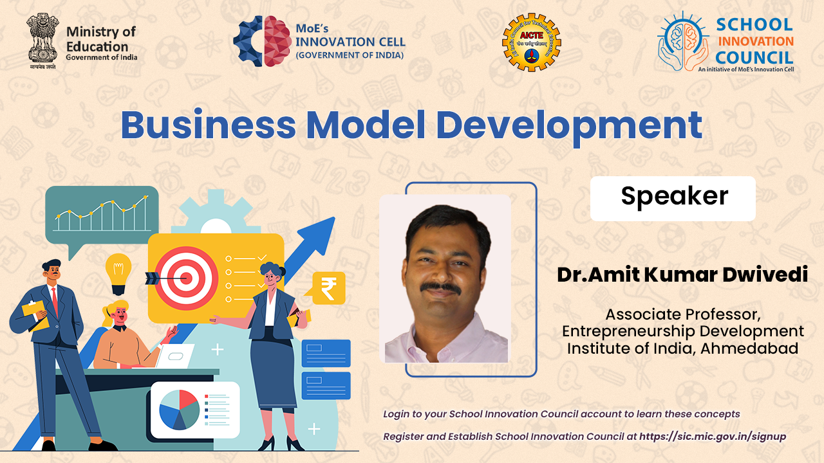
Business Model Development

Slide 29
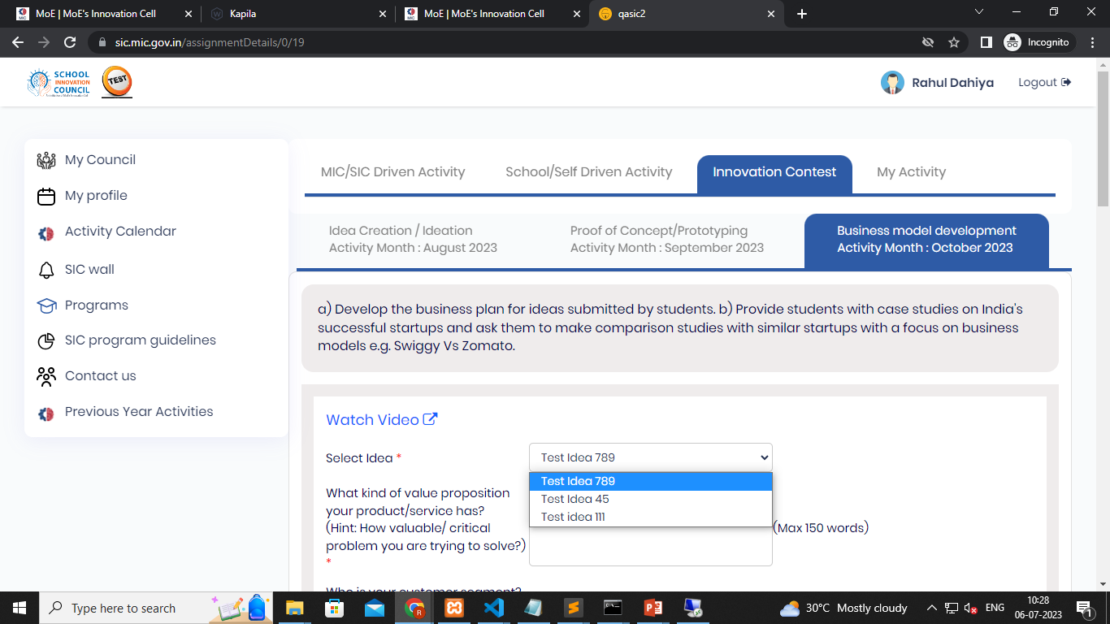
Business Model Development
Only the nominated ideas by the school will move to the Business model development stage for the report submission.

Slide 30
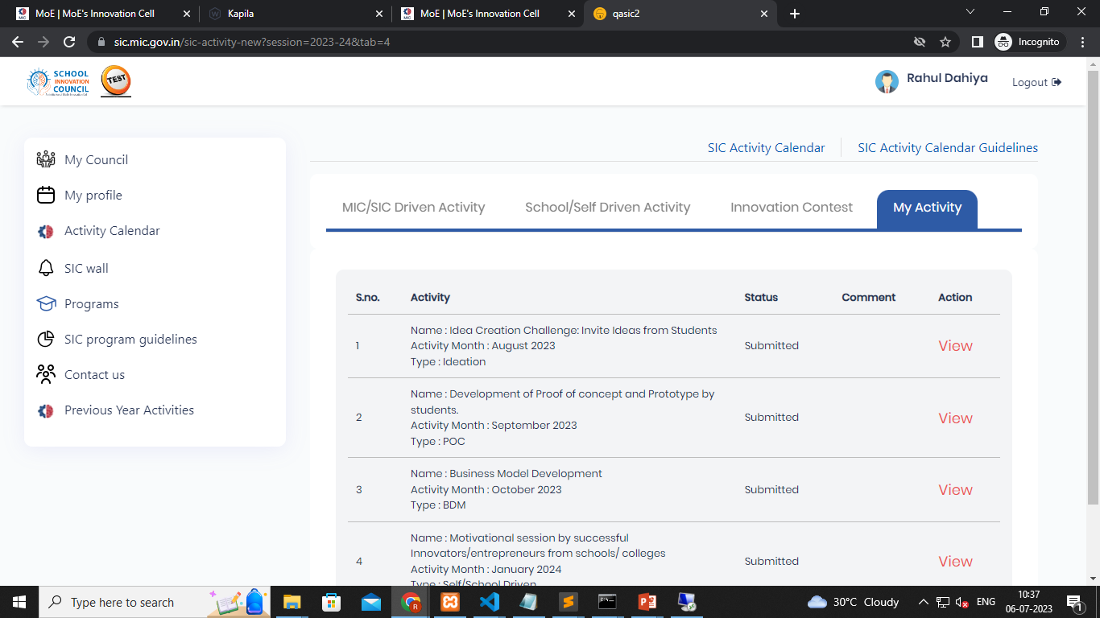
My Activity
Activity completed by the School will be visible in the My Activity tab, where the school can view their activity status, reports etc

Slide 31

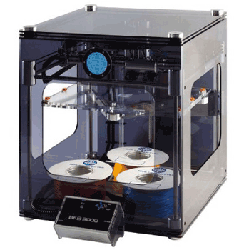
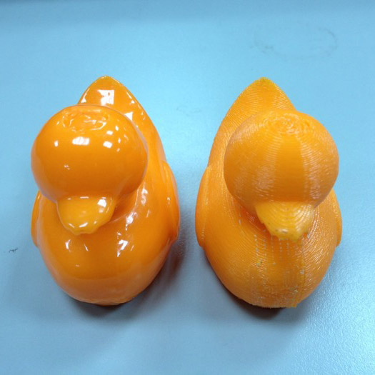

3D Printer

Slide 32

Vapour Smoothing
Vapor Smoothing is a method of polishing to reduce the surface roughness or improve clarity.

Slide 33

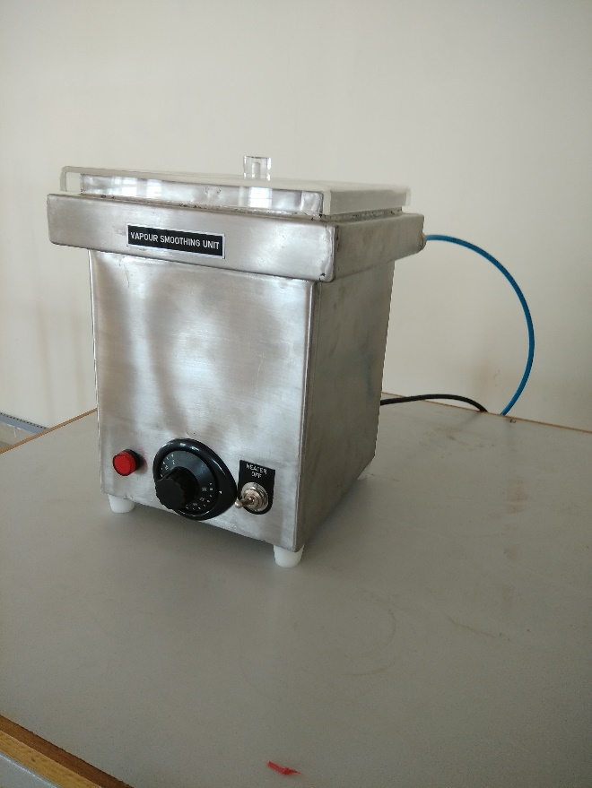
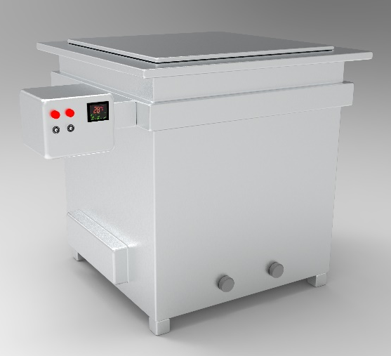
Vapour Smoothing Equipment
Problem
Identification
Proof of Concept
Prototype Development

Slide 34
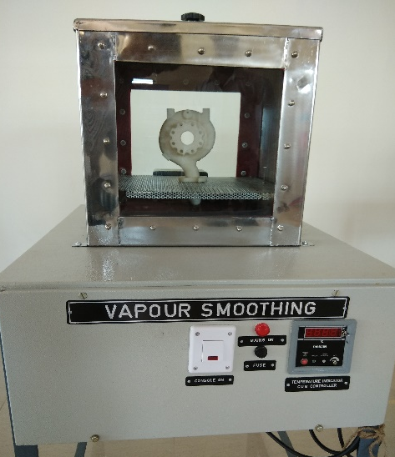
Business Model Development
Product Development
Value Proposition
Resources
Your customer segment
Revenue streams
Partner
Cost
Channels
Customer Relationship
Activities

Slide 35
Vapour Smoothing
Vapor Smoothing is a method of polishing to reduce the surface roughness or improve clarity.

Slide 36

Activity Calendar 2023-24 for PM SHRI SCHOOLS
 | Activity | Mode | Organizer | Month
1 | Leadership talk /Motivational session | Online | MIC | 11th Oct 2023 to 10th Nov 2023
2 | Innovation Contest: Idea Creation Challenge/Ideation: Invite Ideas from Students | Offline | School | 11th Nov 2023 to 10th Dec 2023
3 | Development of Proof of concept and Prototype by students. | Offline | School | 11th Dec 2023 to 10th Feb 2024
4 | Business Model Development Develop the business plan for ideas submitted by students. | Offline | School | 11th Feb 2024/ 31st May 2024
5 | Webinar/Session- Entrepreneurship and Startup support ecosystem in the country | Online | MIC | 01st Jun 2024 to 15th Jul 2024
6 | Session on Intellectual Property Rights | Online | MIC
7 | Motivational Session by successful Innovators/Entrepreneurs | Online | School | 16th Jul 2024 to 14th Aug 2024
8 | Session on Technology Transfer | Online | MIC | 16th Aug 2024 - 14th Sep 2024
9 | Awareness on the basics of “Innovation and Entrepreneurship at the school level” among students through games/ Fairs/ Exhibition/ competitions/ quizzes etc. | Offline | School | 16th Sep 2024 to 15th Oct 2024

Slide 37

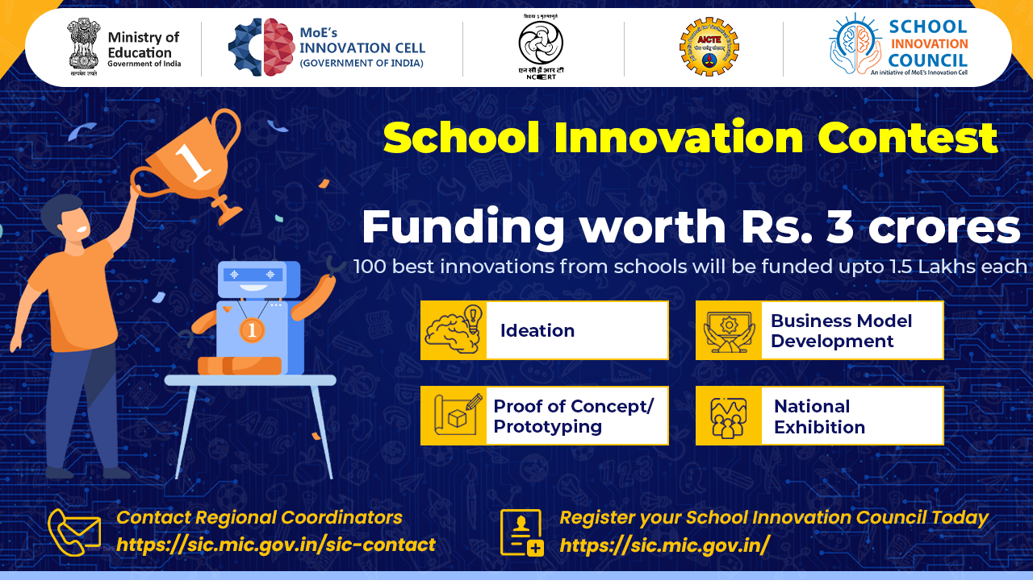
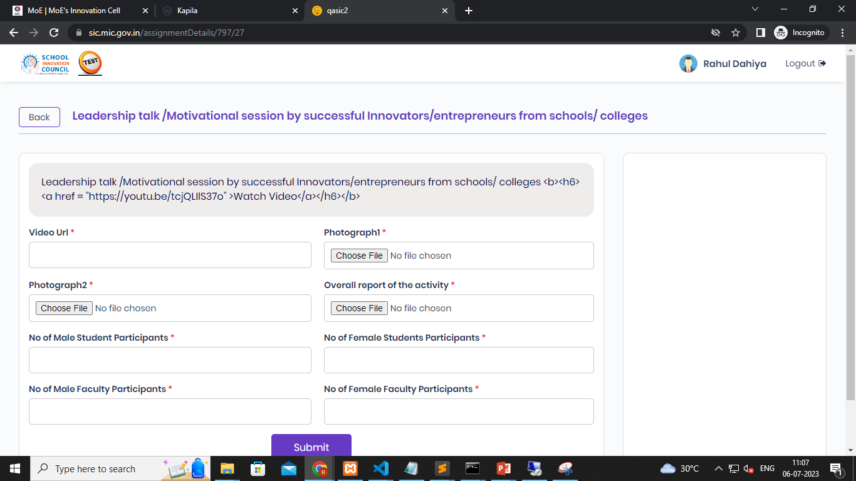
Motivational Session – Report Submission
Submit your Activity report after performing the activity.

Slide 38




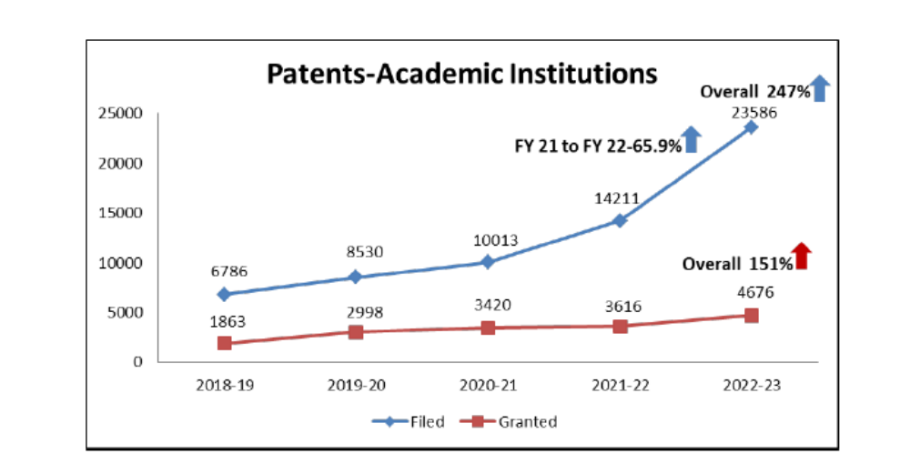
KAPILA - “Kalam Program for IP Literacy and Awareness”
https://kapila.mic.gov.in
Budget Head | Amount in ₹
Patent filing fee | ₹ 1,600/-
Examination fee | ₹ 4,000/-
Amount per Application | ₹ 5,600 /-
Total Amount (Maximum Application 100 per Institute) | ₹ 5,60,000/-

Slide 39
Benefits of HEIs / Incubation Centre’s:
Design / Fabrication Facility
Mentorship Support
Product Development
IP Protection
Technology Transfer

Slide 40
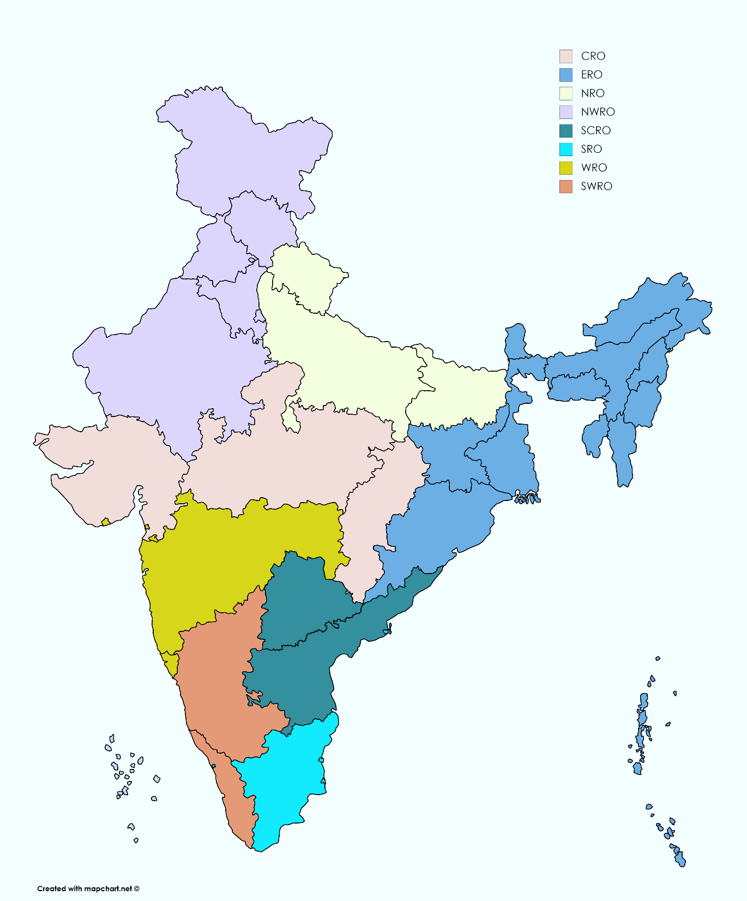
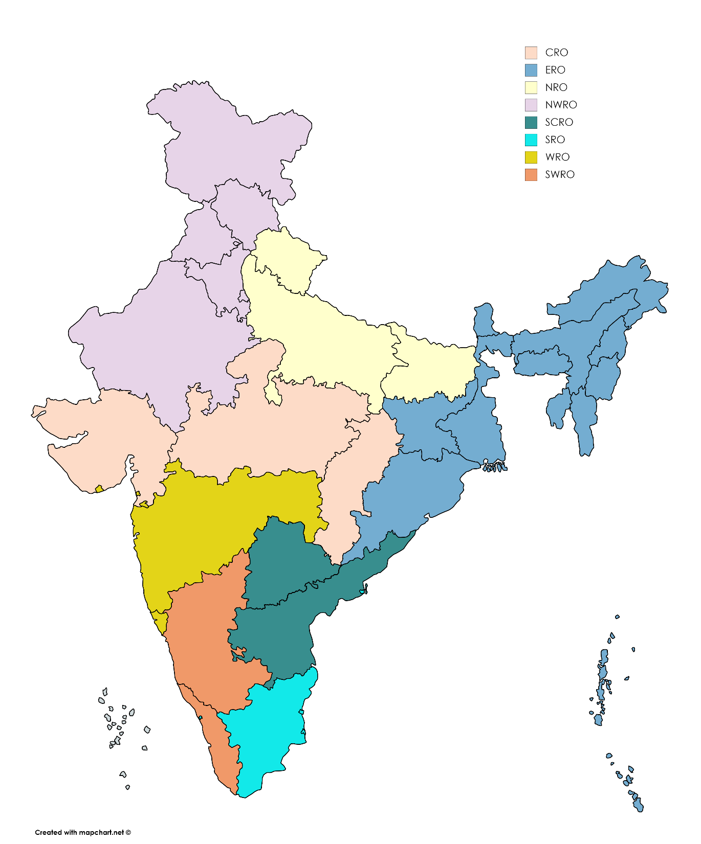
Registered School Innovation Council
School Innovation Council - 5190
PM SHRI Schools-5931
210
2
67
207
203
35
10
137
22
06
209
116
16
147
151
20
52
216
498
38
33
216
934
18
379
280
245
28
20
26
21
164
149
17
21
30
21
16
158
237
32
280
363
170
136
214
42
505
539
12
4
651
127
356
158
518
163
14
60
1
11
8
8
8
20
238
23
271

Slide 41
School Innovation Contest 2023-24
Theme wise Ideas received till data in SIC Innovation Contest – (SIC 4179+Jr SIH2556) = 6735
Theme | Ideas Count
Healthcare & Biomedical devices | 621
Sustainable Environment | 386
Waste Management/Waste to Wealth Creation | 406
Agriculture, Foodtech & Rural Development | 299
Renewable and Affordable Energy | 256
Smart Vehicles/ Electric vehicle/ Electric vehicle motor and battery technology | 446
Other Emerging Areas Innovation for Start-up | 223
Software / App Development | 197
Smart Cities | 183
Disaster Management | 121
Heritage & Culture | 53
ICT, cyber-physical systems, Blockchain, Cognitive computing, Cloud computing, AI & ML | 92
Smart Textiles | 18
Finance Life Sciences | 10
Clean & Portable Water | 101
Medtech/ Biotech/ Healthcare | 313
Toys & Games | 62
Transportation & Logistics | 93
Theme | Ideas Count
IoT based technologies | 156
Robotics & Drones | 283
Smart Education | 308
Clean & Green Technology | 239
Education | 90
Food Processing/Nutrition/Biotech | 93
Block chain & Cybersecurity | 74
Defence & Security | 85
Travel & Tourism | 143
Infrastructure | 71
Consumer Goods and Retail | 62
Manufacturing | 63
Fitness & Sports | 77
Fashion and Textiles | 47
Mining, Metals, Materials | 8
Miscellaneous | 207
Quantum Computing | 2
Renewable/ Sustainable Energy | 173
Smart Automation | 277
Space Technology | 35
Agriculture & Rural Development | 321

Slide 42

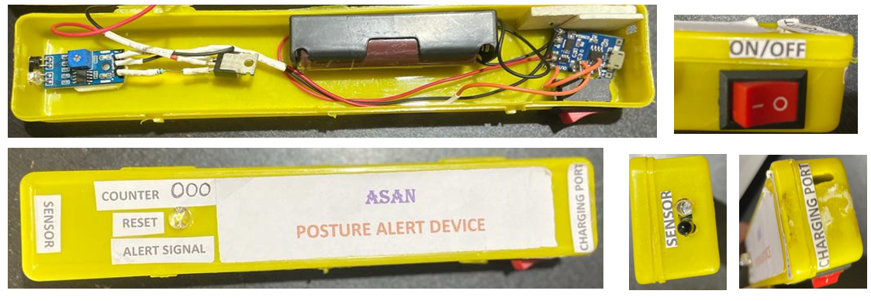
School Innovation Contest
Theme - MEDTECH/ BIOTECH/ HEALTHTECH
School Name: Future Bhubaneswar School
Idea ID: 1939
Innovation Title: Posture Alert Device
  An alert device to alert a user whenever he/she is not in the correct posture or not at a recommended distance e.g. leaning more forward or reading a book or operating an electronic device (phone) at a closer distance.

Slide 43
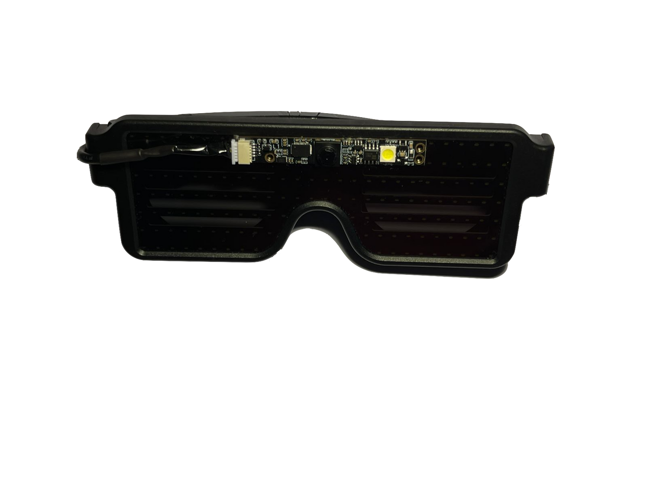
Theme - Medtech/ Biotech/ Healthtech
School Name: Jayshree Periwal International School
Idea ID: 1459
Innovation Title: Sightsense - Affordable Portable Assistive Reading Device for the visually impaired
Enables access to any written content - textbooks, newspapers, novels etc.
Detect 1000+ everyday Objects
Detect Text In 2 Languages - Hindi and English
Identify Food and Currency
15x cheaper than current assistive tech.
Sleek design, under 150g, maximizes. comfort and accessibility
Detect Any Font & Handwriting
High-accuracy text extraction in real-world conditions.
Uses Raspberry Pi 3b+ with Bluetooth for interactive portable reading.
Command Operated With Voice Activation
Can read a year’s worth of reading material in only 600INR.
Notes:
‹#›

Slide 44
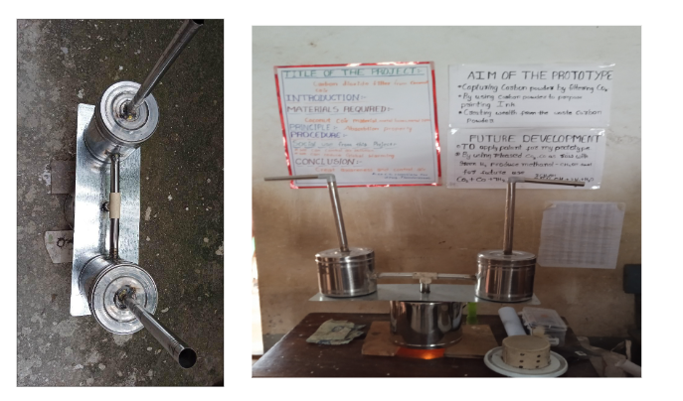
Idea ID: 21552
School Name: Zilla Praja parishad High School, Thondavaram
Theme/Sector of Focus: Sustainable Environment
Innovation Title: Carbondioxide Filter From Coco Coir Material
Innovative Coconut Coir Filter to reduce air pollution. When the carbon dioxide passes through the filter, it captures Adhesive carbon particles from carbon dioxide and releases purified carbon dioxide.

Slide 45
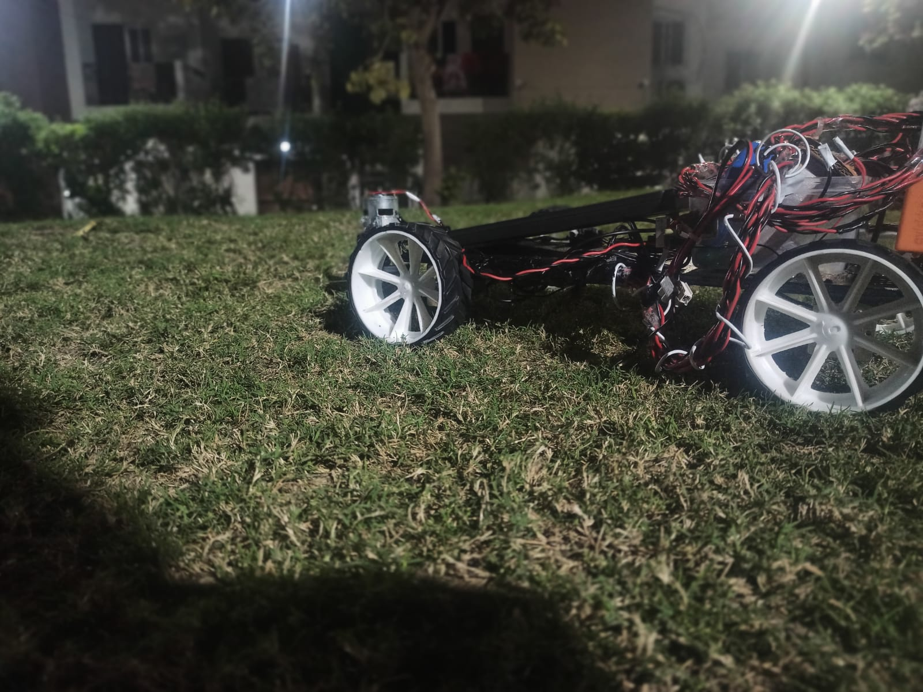
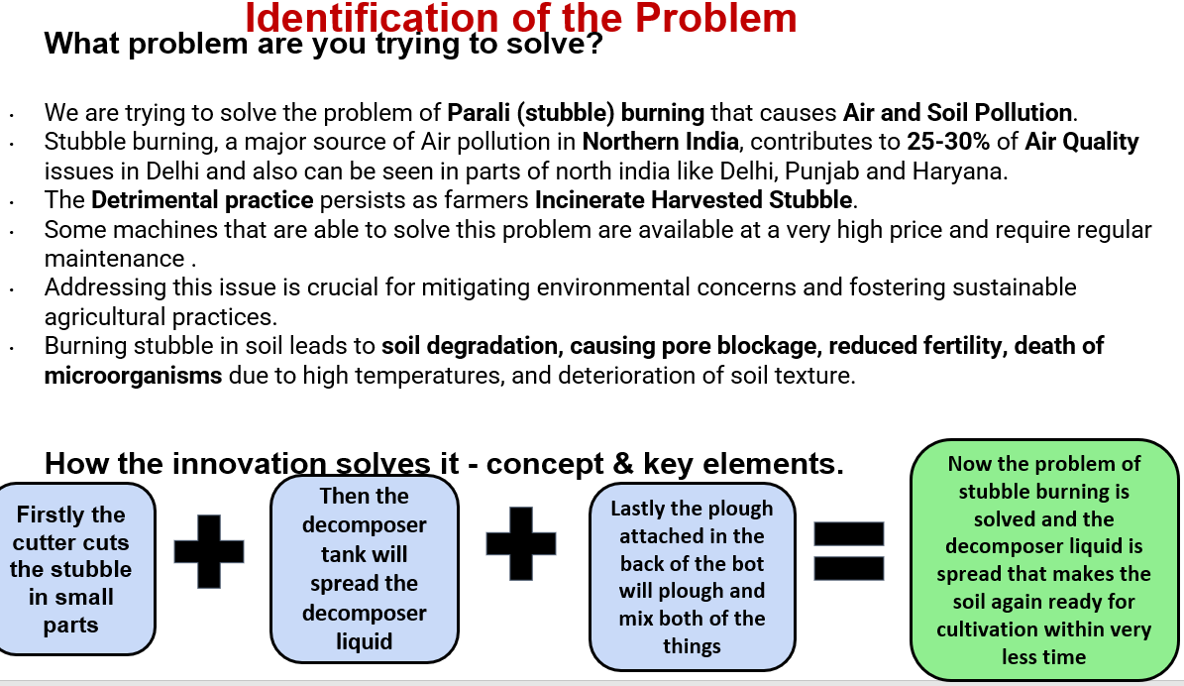
Idea ID: 788
Innovation Title: Stubble Management system
Theme: Agricultural Food Tech and Rural development
School Name: Sagar Public School, Rohit Nagar
Stubble burning, a major source of Air pollution in Northern India, contributes to 25-30% of Air Quality
Issues in Delhi can also be seen in parts of north India, such as Delhi, Punjab, and Haryana.

Slide 46
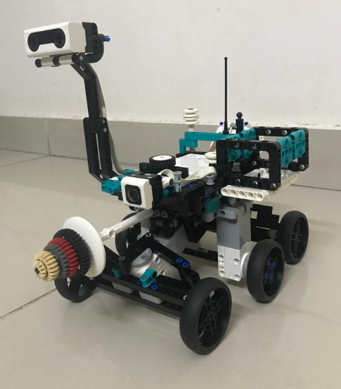
Idea ID: 905
Innovation Title: Novel Search & Rescue Robotic systems to save life of victims affected by natural disasters like earthquakes and landslides
School Name: Sri Kumaran Children’s School
Theme : ROBOTICS AND DRONES
A remote-controlled Rover Robot is designed & developed to autonomously search victims and provide aid & save their valuable life.
ROVER does the necessary Audio & Video communication to base stations.

Slide 47
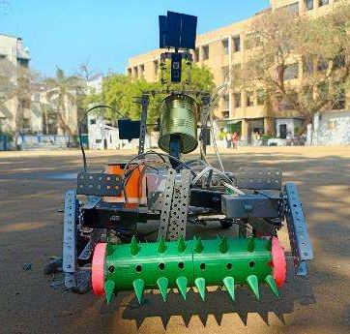
Idea ID: 17945
Theme/Sector of Focus: Agriculture & Rural Development
Innovation Title: FARMBOT
The Farmbot - A cost-effective robotic farming solution
The Farmbot prototype integrates a precision plougher, soil moisture sensor, sprinkler system, and Aavishkaar Brain for intelligent control.
These components aim to enhance farming efficiency, reduce labor, and improve overall productivity. Ongoing testing ensures seamless integration and optimal performance in real-world farming scenarios.

Slide 48
School Innovation Ambassador Training Program (SITAP)
https://sia.mic.gov.in

Slide 49
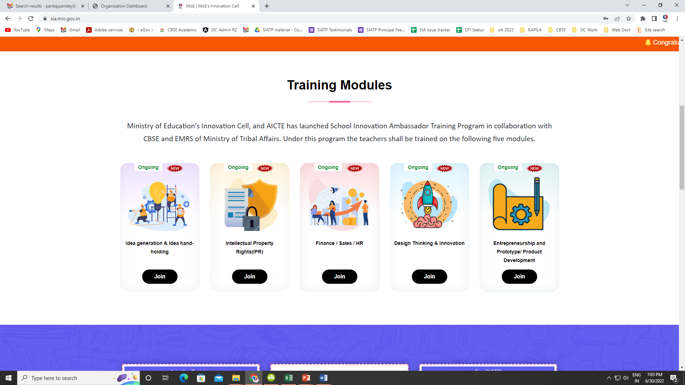
https://sia.mic.gov.in
School Innovation Ambassador Training Program (SITAP)
Five modules (72 hours)
https://sia.mic.gov.in

Slide 50
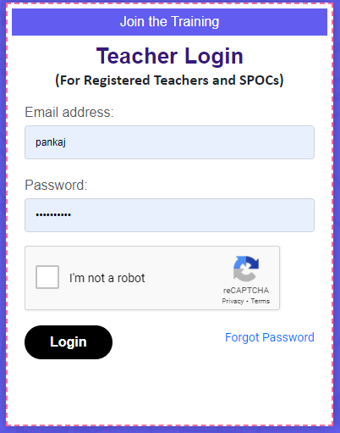
SIATP Process –end to end digital
School
Register on SIATP Website
Nominate Teachers/ Self Registration
Attend training
Teachers login
Innovation Ambassador of MoE
Assessment (score > 50%)

Slide 51
Why School Innovation Ambassador Training Program (SIATP):
To train the school teachers across country who will nurture the young school students on Ideation, design thinking, problem-solving, critical thinking and IPR, Product development.
T1
T1
T1
T1
T1
Role of the ‘Innovation Ambassadors’
Help in creating the culture of Innovation in their respective schools
Establishing the School Innovation Council in schools and act as members of that council

Slide 52
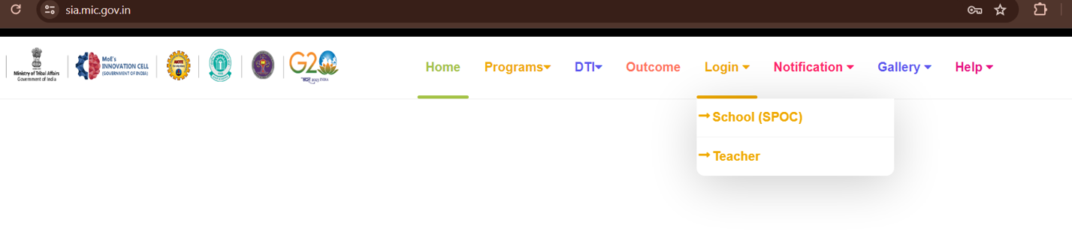
SIATP Process –end to end digital
For registration and login for SPOC/Teacher

Slide 53
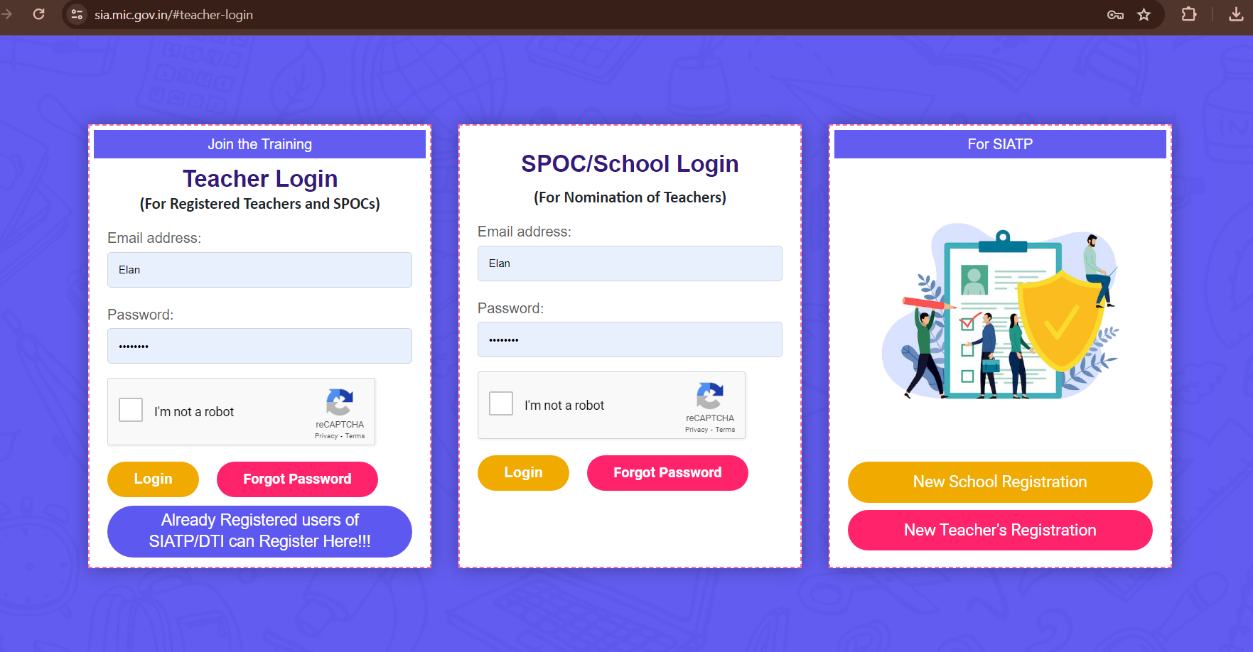
SIATP Process –end to end digital

Slide 54

Benefits of SIATP
Innovation Ambassadors badge from Ministry of Education
Free training by Government
Help in career advancement
6 Certificates from the Ministry of Education’s Innovation Cell
Trained teachers will become part of the School Innovation Council.
T1
T1
T1
T1
T1

Slide 55






School Innovation Ambassador Training Program
Design Thinking and Innovation
Idea Generation and Hand holding
Entrepreneurship Prototype and Product Development
IPR
Finance, Sales and HR
Training Modules
Teachers Registration: 78736
Schools Registered: 13001
Teachers completed : 24553
Spread Across: 28 States, 8 UTs

Slide 56
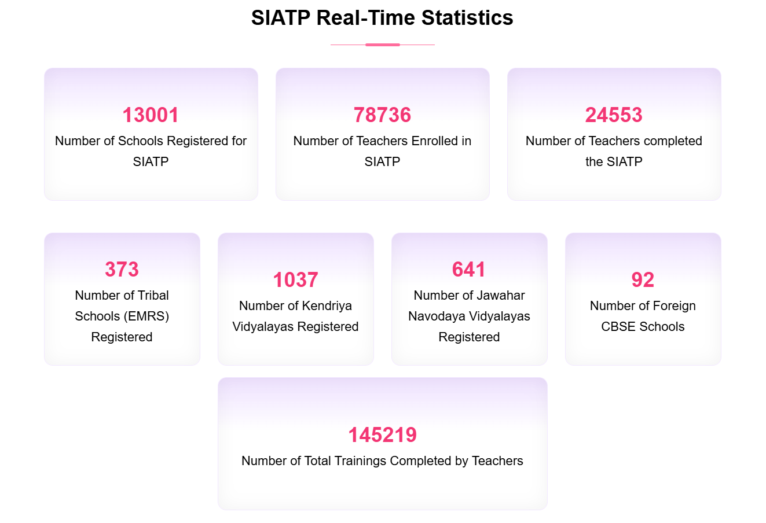
School Innovation Ambassador Training Program

Slide 57
School Innovation Ambassador Training Program
Certificates
Completion of each Module – Teachers can download the Certificate
Minimum Criteria to get certified - 50% Marks in the assessment.
Completion of all 5 Modules – Teacher CAN DOWNLOAD Innovation Ambassador Certificate.
Link to the portal https://sia.mic.gov.in

Slide 58
Design Thinking and Innovation Skill Module for School
https://sia.mic.gov.in/dti-modules

Slide 59







Design Thinking & Innovation Skill Subject Books
As Skill Module in Middle school: Modules 1, 2 & 3
As Skill subject in classes
IX to XII

Slide 60

Design Thinking and Innovation Skill Module for School
Schools Initiated 2480
Skill Module to 6th-12th standard
India is the first country in the world to introduce a Design Thinking and Innovation Module at the school level
Students Enrolled
1.28 Lakh
Teachers Trained
5,789

Slide 61
Design Thinking
Design thinking is an iterative method that helps solve problems by understanding user needs and coming up with solutions that meet those needs.
It is a human-centric approach that can be used to solve complex problems.

Slide 62
The five phases of design thinking:
Empathize: Understand the users' needs by observing and interacting with them.
Define: Define the problem you are trying to solve based on your understanding of the users' needs.
Ideate: Brainstorm solutions to the problem.
Prototype: Create a prototype of your solution to test with users.
Test: Test your prototype with users and get feedback.

Slide 63
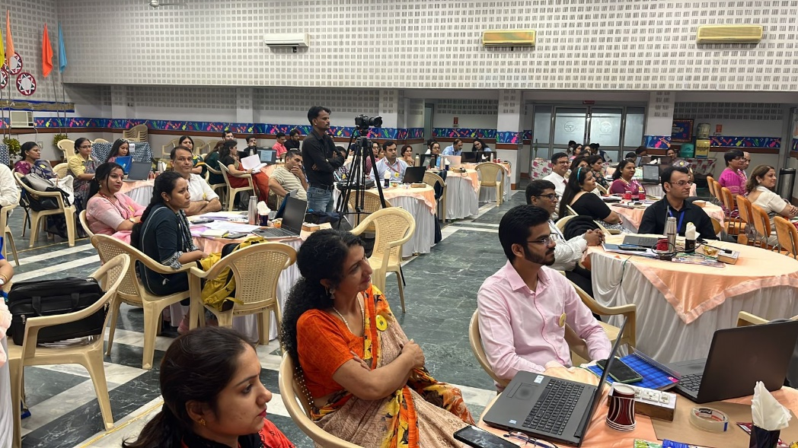
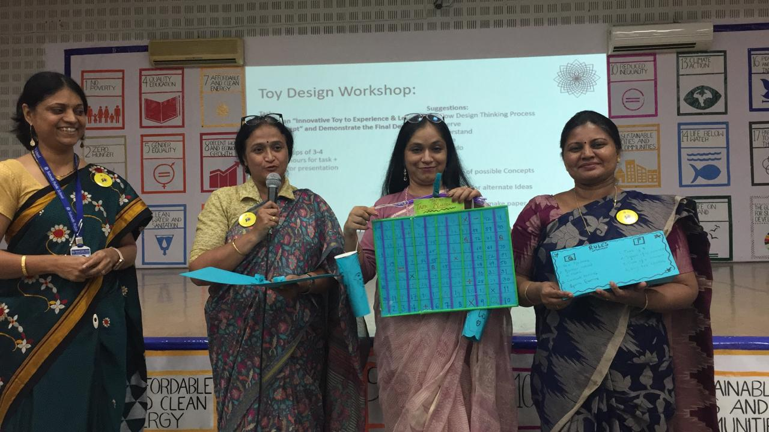
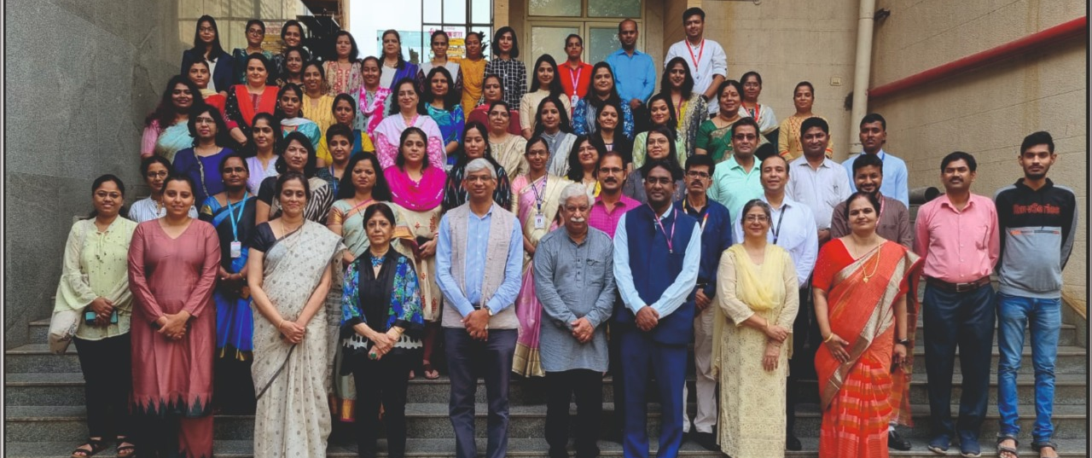
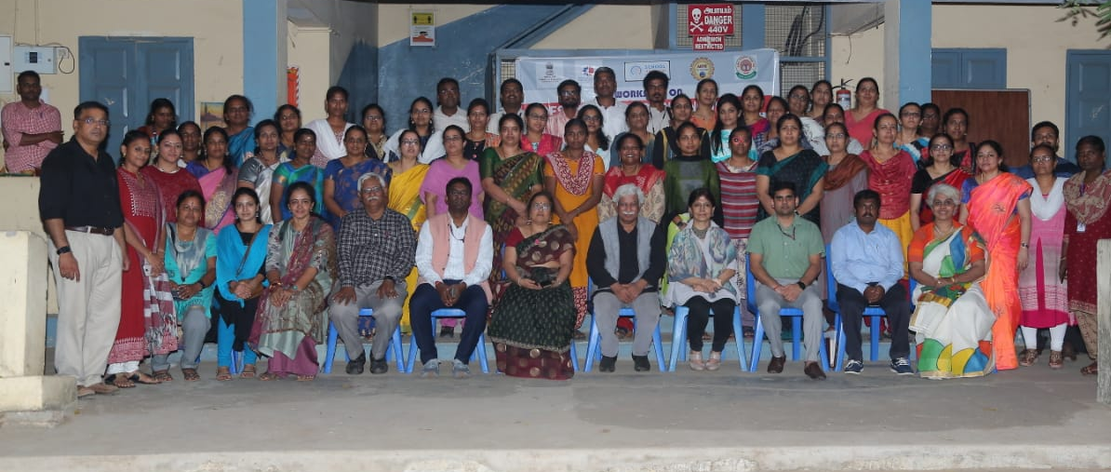
Design Thinking and Innovation Skill Module for School

Slide 64
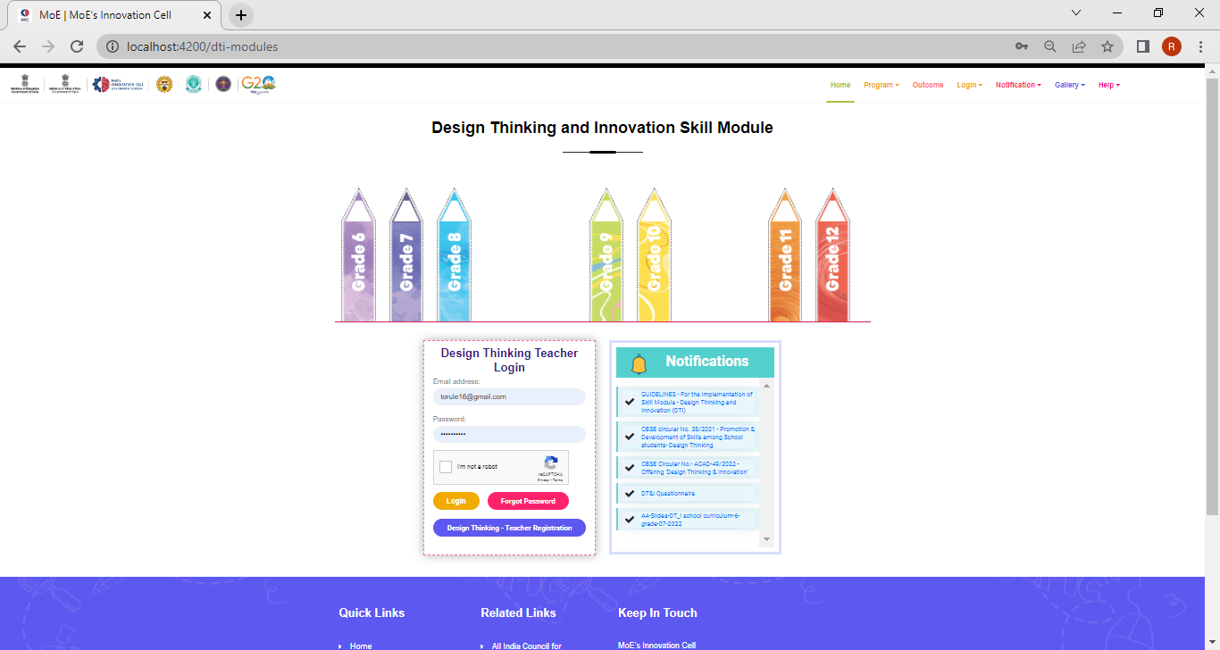
DTI Login
DTI registration
https://sia.mic.gov.in/dti-modules

Slide 65
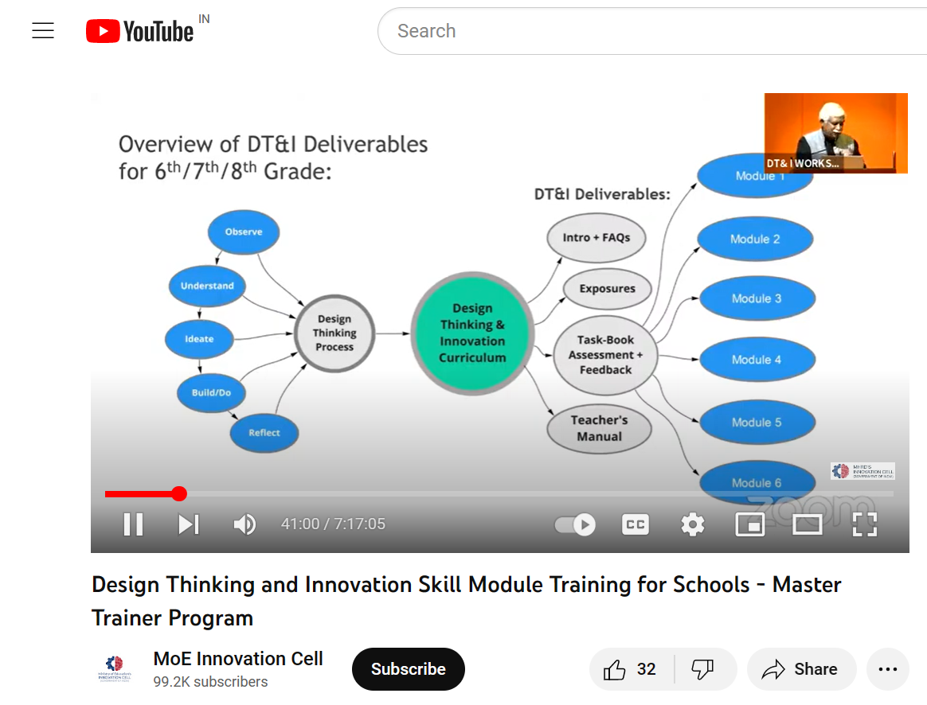
DTI Module Session link - YouTube
https://www.youtube.com/watch?v=6-5J6YTrYf4

Slide 66
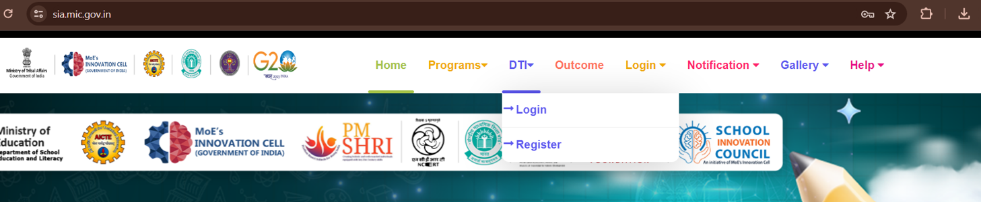
DTI Process –end to end
For registration and login for Teacher in DTI

Slide 67

DTI Process –end to end
For new registration you need to fill some basic details

Slide 68

DTI Process –end to end
After successful Registration go for Login

Slide 69

After Login, the Teachers can access to resource materials

Slide 70


Slide 71
IDE Bootcamps for PMSHRI Schools
4 Nodal Centre’s - Details
Sr. No | State
1. | Bhopal, Madhya Pradesh
2. | Jaipur, Rajasthan
3. | Mumbai, Maharashtra
4. | Noida, Uttar Pradesh

Slide 72




Innovation, Design and Entrepreneurship (IDE) Bootcamp
Plan for IDE Bootcamps
2
Training Modules
Design Thinking for Entrepreneurs
Human Centred Approach to Opportunity Discovery
Designing Success: Competitive Advantage and Differentiation Strategies in Startups
Building Sustainable Business model & Digital presence for startups
Overview on Grants and Funding opportunities for student start-up & Pitch Your Idea
Phases of Bootcamps
18
IDE Bootcamps in 14 states
90
Trainers and Experts
3900+
Participants

Slide 73


T1
T1
T1
T1
T1
T1

Slide 74
Telegram Group
Single Point of Contact (SPOC) of School
https://t.me/joinchat/RcI5Qp80TO9mZjZl
Teacher- https://t.me/joinchat/HIiBtHUN-6I3ZDM1

Slide 75
Regional Officers
Region 2
Uttarakhand
Arunachal Pradesh
Uttar Pradesh
Manipur
Assam
Sikkim
Tripura
Meghalaya
Delhi
Mizoram
Nagaland
Region1
Andhra Pradesh
Kerala
Karnataka
Tamil Nadu
Andaman & Nicobar
Lakshadweep
Pondicherry
Telangana
Region 1
Bihar
Chhattisgarh
Jharkhand
Maharashtra
Goa
Odisha
Dadra & Nagar Haveli
West Bengal
Daman & Diu
Jammu & Kashmir
Region3
Region4
Jammu & Kashmir
Punjab
Chandigarh
Leh & ladakh
Himachal Pradesh
Gujarat
Haryana
Madhya Pradesh
Rajasthan
Mr. Mayur Borkar
sicr3@aicte-india.org
8130617707
Mr. Shivendra Mani Tripathi
sicr4@aicte-india.org
01129581344/6388554380
Dr. Pooja Rawat
sicr1@aicte-india.org
01129581509
Dr. Pooja Rawat
sicr2@aicte-india.org
01129581509
Program In charge
Dr. Elangovan Kariappan
Assistant Innovation Director
Innovation Cell, Ministry of Education, Government of India
Email: schoolinnovation@aicte-india.org

Slide 76
Thank you
Contact Us for Any Doubts/Queries
Contact-us page URL :
https://sic.mic.gov.in/sic-contact
Email: schoolinnovation@aicte-india.org
https://sic.mic.gov.in

Slide 77
Thank You

Slide 78
Frequently Asked Questions (FAQ)
School Innovation Ambassador Program
An Initiative by Ministry of Education
Implemented by Ministry of Education’s Innovation Cell, AICTE
https://sia.mic.gov.in/

Slide 79
Frequently Asked Questions (FAQ)
Q: Who are eligible to be nominated for School Innovation Ambassador training Program?
A: All the teachers of schools.
Q: Who can Nominate the Teachers?
A: Single Point of Contact (SPOC) from School can nominate the teachers. Preferably Principal / Vice Principal or Senior School Teacher should be the SPOC.
Q:Can Individual teachers register themselves for training? A: No. Only SPOC should register the teachers on SIA portal.
Q: What does SIATP stands for
A: School Innovation Ambassador Training Program.
Q: Can SPOC, Principal, Vice - Principal be nominated for SIATP training? A: Yes

Slide 80
Frequently Asked Questions (FAQ)
Q: Who can login on SIATP website?
A: Registered SPOC (in SPOC Login) & Nominated Teachers (Teachers Training Console). Q:Can SPOC be changed after registration?
A: Yes. The existing SPOC can nominate the new SPOC in SPOC login. During new SPOC Nomination, the verification link will be sent on new email and SPOC can’t login without verifying the email.
Q: My SPOC has left the school, what to do?
A: Principal / Vice Principal can login with the existing SPOC email and nominate new SPOC.

Slide 81
Frequently Asked Questions (FAQ)
Q: Can I nominate more than five teachers for SIATP training?
A: Yes
Q: Will nominated teachers get separate login ID, password for attending the training on SIATP website?
A: Yes. The nominated teachers can login with the registered email ID and default password (siatp@2021) in teacher’s login on https://sia.mic.gov.in/
Q:What will be the timing for training
A: All the five training module are self paced and teachers can attend them at their convenience before the date of completion.
Q: What is the role of SPOC.
A: Nominate teachers from the school, and help/guide them to attend the training on https://sia.mic.gov.in/. Q: SPOC have registered teacher with wrong details can SPOC edit the details?
A: Yes. Use the Edit option in front of the concerned teacher in your SIA login dashboard.

Slide 82
Frequently Asked Questions (FAQ)
Q: Where to attend the training?
A: https://sia.mic.gov.in/
Q: Will the training be online or offline?
A: Online
Q:I have forgot my password, what to do?
A: Use forgot password and reset the password Q:Where to attend the training?
A: https://sia.mic.gov.in/
Q: How can I download certificate for each training?
A: Visit ‘Home’ page of your SIATP dashboard to check the status of each training module and download the certificate. To download it in correct format, use desktop view mode.
Q: What is criteria of getting a certificate for training?
A: To qualify a training module and getting a certificate, minimum marks percentage is 50%.

Slide 83
Frequently Asked Questions (FAQ)
Q: How to access the School Innovation Ambassador Training Program (SIATP) Modules?
A: Login with your registered Email ID on the website https://sia.mic.gov.in
Q: What is a Registered Email ID?
A: All the teachers nominated by the Schools through the Single Point of Contact (SPOC) are the registered/ nominated teachers and the email given during teacher’s nomination is the registered email ID.
Q: I forgot my registered Email ID. Can I retrieve it?
A: Contact the SPOC. SPOCs can see the details of all the nominated teachers from their school including the registered Email ID.

Slide 84
Frequently Asked Questions (FAQ)
Q: SPOC forgot their email ID, what to do?
A: SPOC shall write the email to their regional coordinator with the following details. SIC ID (unique ID given by MIC, appears in SPOC login) or (Name, School Name, City, and State).
Q: Who are the regional coordinators?
A: Regional coordinators are the officers from the Innovation Cell of the Ministry of Education managing the four regions. For more details visit the contact us page: https://sia.mic.gov.in/contact-us
Q: What are the regions?
A: Innovation Cell of the Ministry of Education has segregated the schools state-wise and clubbed them under four regions. Find more details on the contact us page: https://sia.mic.gov.in/contact-us

Slide 85
Thank You

